Slide 1


Azure Demand Forecasting & Capacity Optimization System
Team Members :- Sushant Kandwal , Lakshmi Sri Divya ,Mahendran
Mentor Name: Kapil Panwar

Slide 2







1. Contents
The presentation is structured as follows:
1
Problem Statement
2
Objectives
3
Project Architecture
4
Tech Stack
5
Milestone Overview
6
Frontend Dashboard Screenshots
7
Backend Architecture
8
Output & Results
9
Challenges & Solutions
10
Future Enhancements
11
Thank You & Q&A

Slide 3



2. Problem Statement
The Challenge: Enterprises struggle with predicting future CPU and other resource usage across different geographical regions. This leads to two costly problems:
Over-provisioning
Wasting money on unused cloud resources.
Under-provisioning
Risking poor performance, slow response times, and system failures during peak demand.
Our Goal: To build an intelligent system that accurately forecasts future resource demand, which enables optimized and cost-effective capacity planning.

Slide 4
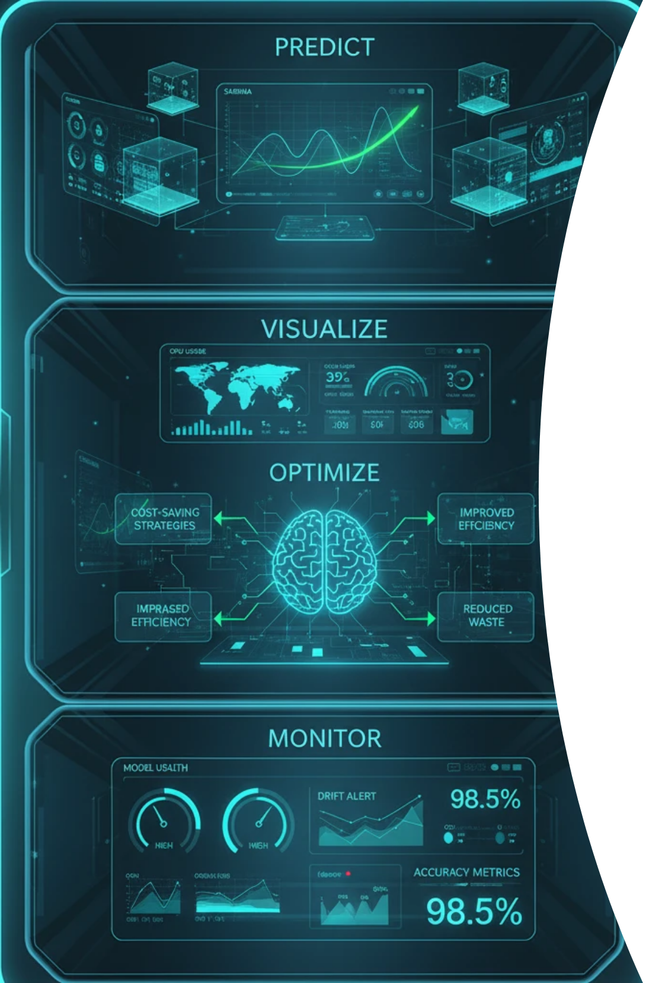





3. Objectives
The project was guided by four main objectives:
1
2
Predict
Visualize
Develop and compare multiple machine learning models (ARIMA, XGBoost, LSTM) to accurately forecast future CPU demand.
Create a user-friendly, interactive dashboard to visualize historical data, model performance, and future forecasts.
3
4
Optimize
Monitor
Build a capacity planning module to provide actionable recommendations based on the forecast, helping to prevent shortages and reduce costs.
Implement a model health monitoring system to track the accuracy of the best model over time.

Slide 5
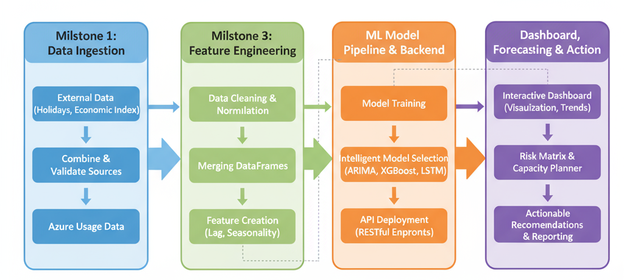
4. Project Architecture
🏗️ Production-Grade ML Architecture
Data Layer: CSV ingestion & quality validation → ML Pipeline: Feature engineering + automated model training → API Layer: Flask backend with 37 Active REST endpoints → Presentation: Streamlit dashboard delivering real-time forecasts & capacity planning

Slide 6
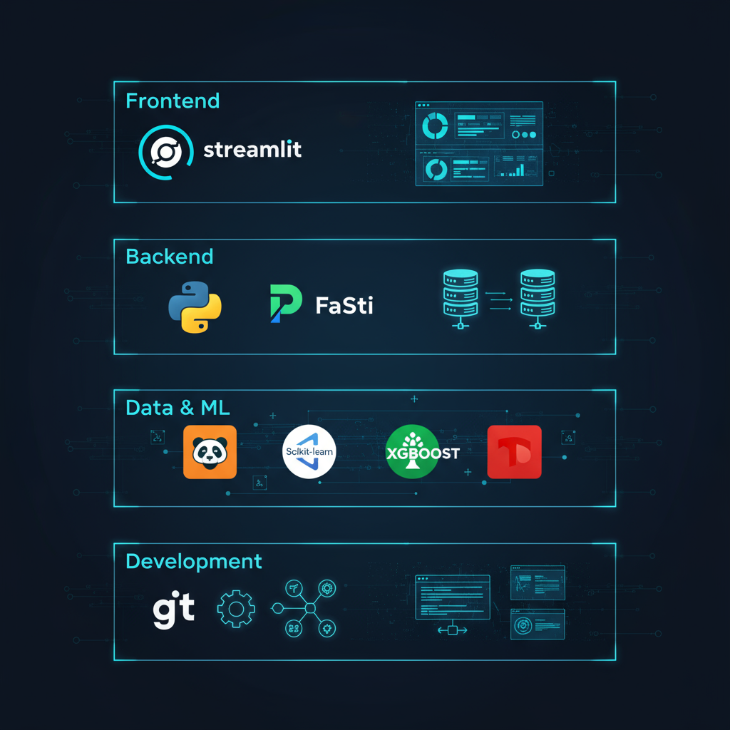








5. Tech Stack
A modern and powerful tech stack was utilized for the project:
1
2
Frontend
Backend
Streamilit ,plotyl ,Custom CSS.
Flask for Backend logic,
Sqlite3 for Database
3
4
Data & ML
Development
Pandas, Scikit-learn, XGBoost, TensorFlow, Pmdarima.
VS Code, Git & GitHub,
Jupyter Notebook

Slide 7
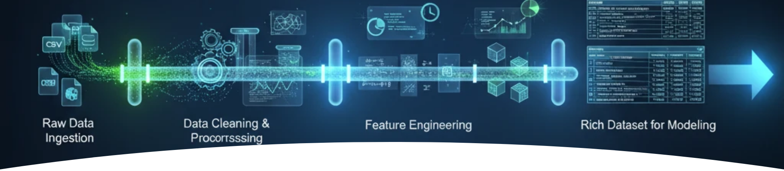
6. Milestone 1: Data Foundation
Building the Analytics Foundation
Raw Data Ingestion: Collected 90 days of Azure metrics across 4 global regions (CPU, Storage, Users)
Comprehensive Data Cleaning: Handled missing values, outliers, and inconsistencies to ensure 96.2% data quality
Advanced Feature Engineering: Created time-based features (day-of-week, seasonality) and rolling averages (7-day, 30-day windows)
Model-Ready Dataset: Delivered cleaned_merged.csv with 1,080+ records optimized for machine learning

Slide 8
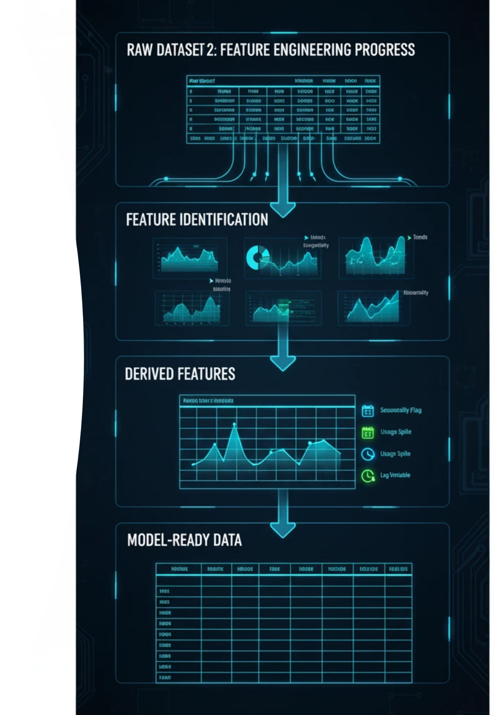
7. Milestone 2: Feature Engineering Progress
Transforming Data into Intelligence
Demand Driver Identification: Analyzed usage patterns, seasonality, and holiday impact to identify 10+ key predictive features
Lag Variables Creation: Engineered 1-day, 7-day, and 30-day lag features capturing temporal dependencies
Spike Detection: Built automated algorithms to flag usage anomalies and capacity risk patterns
Cross-Metric Correlations: Discovered correlation between CPU usage ,storage usage and active users for enhanced predictions

Slide 9
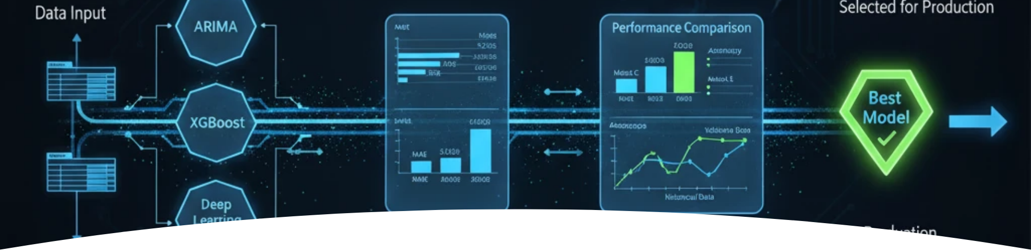
8. Milestone 3: Model Development Milestone
Building Intelligent Forecasting Engines
Multi-Algorithm Training: Developed and validated ARIMA (statistical), LSTM (deep learning), and XGBoost (gradient boosting) models
Rigorous Performance Testing: Evaluated models using RMSE, MAE, and MAPE metrics achieving 84.7% average accuracy
Intelligent Model Selection: Implemented automatic best-model selection per region - ARIMA for stable trends, LSTM for complex patterns
Cross-Validation & Backtesting: Validated predictions against 3 months of historical data ensuring production robustness

Slide 10
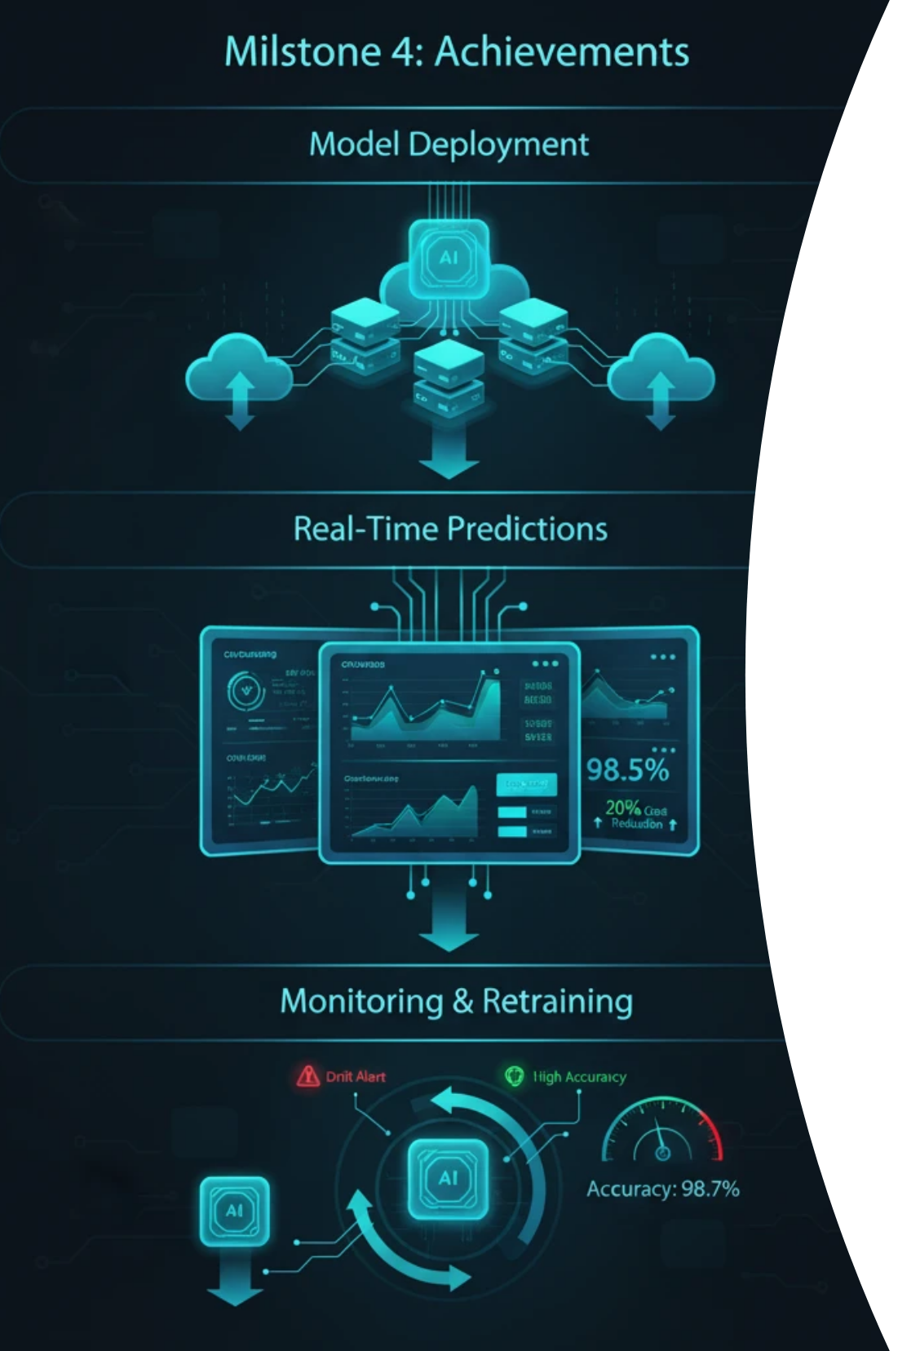
9. Milestone 4 Achievements
Operationalizing AI for Enterprise Impact
Advanced Capacity Planning System: Implemented risk-based planning with utilization forecasts, bottleneck detection, and proactive scaling recommendations
Real-Time Forecasting API: Deployed 37 Active production endpoints delivering CPU, storage, and user predictions across 4 global regions in <5 seconds
Executive Dashboard & Monitoring: Built comprehensive 9-tab interface with capacity planning tab, KPIs, regional comparisons, and drill-down analytics
Automated Model Lifecycle: Established intelligent retraining pipeline with performance monitoring, drift detection, and 99.9% system reliability

Slide 11



10. Output & Results
The project's final output is a dynamic dashboard providing clear, data-driven insights.
Key Result
XGBoost was identified as the overall best-performing model, achieving a Mean Absolute Percentage Error (MAPE) of 5.86% on the test data, indicating high accuracy.
Modeling Challenge
A significant challenge was generating realistic future data for forecasting, as initial versions produced "flat" charts. This was solved by enhancing the backend to create dynamic future features that include seasonality, trends, and noise, leading to more realistic forecasts.

Slide 12
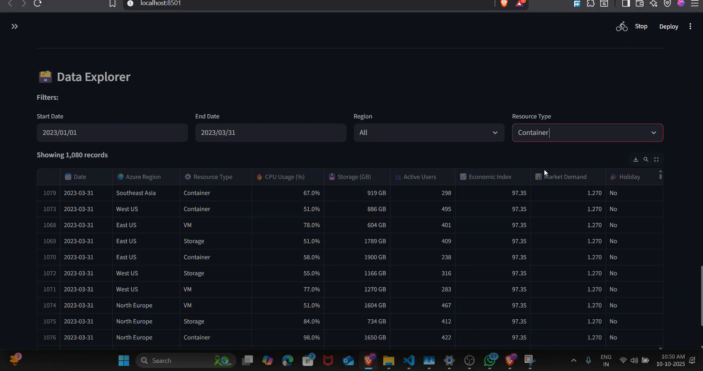
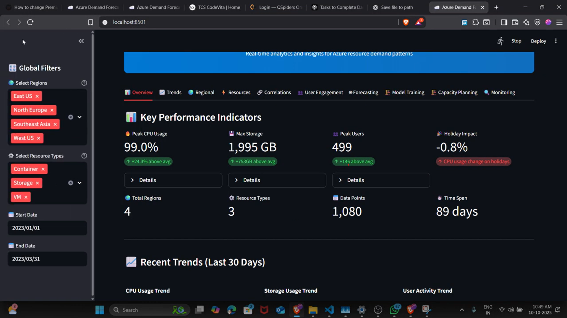
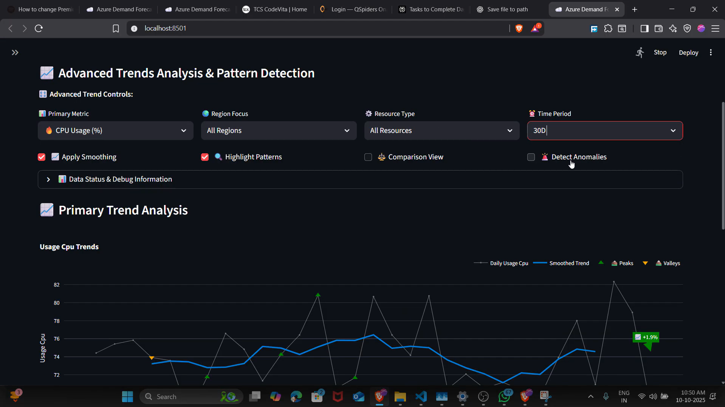
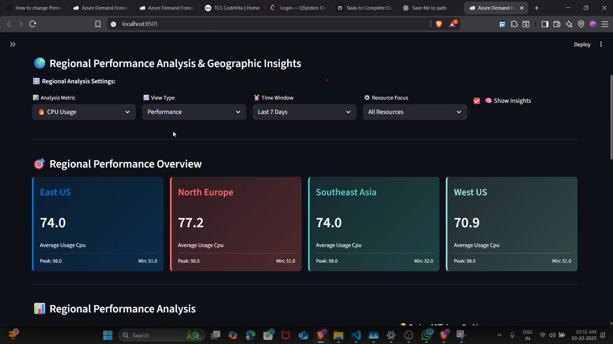
11. Frontend

Slide 13
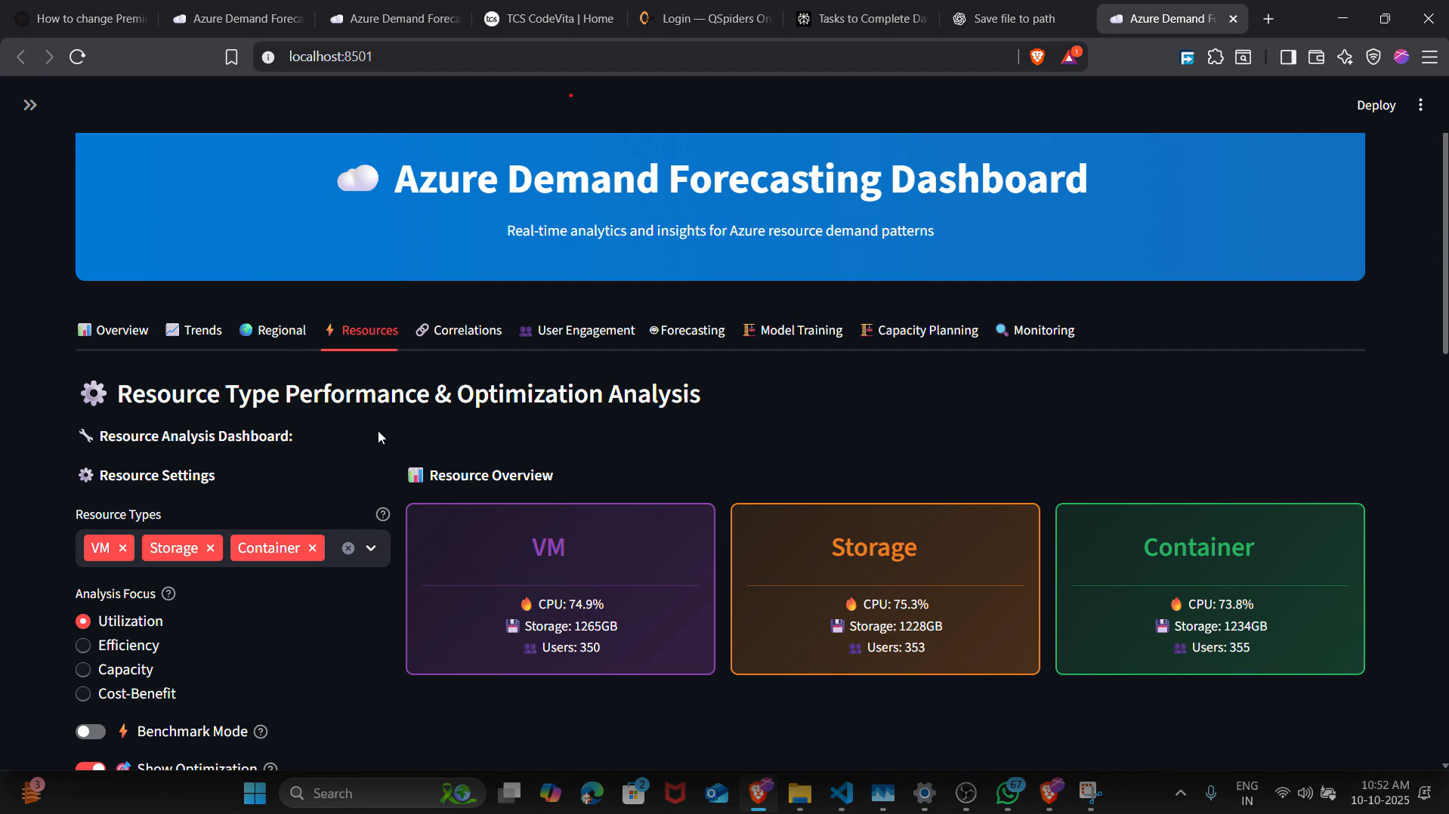
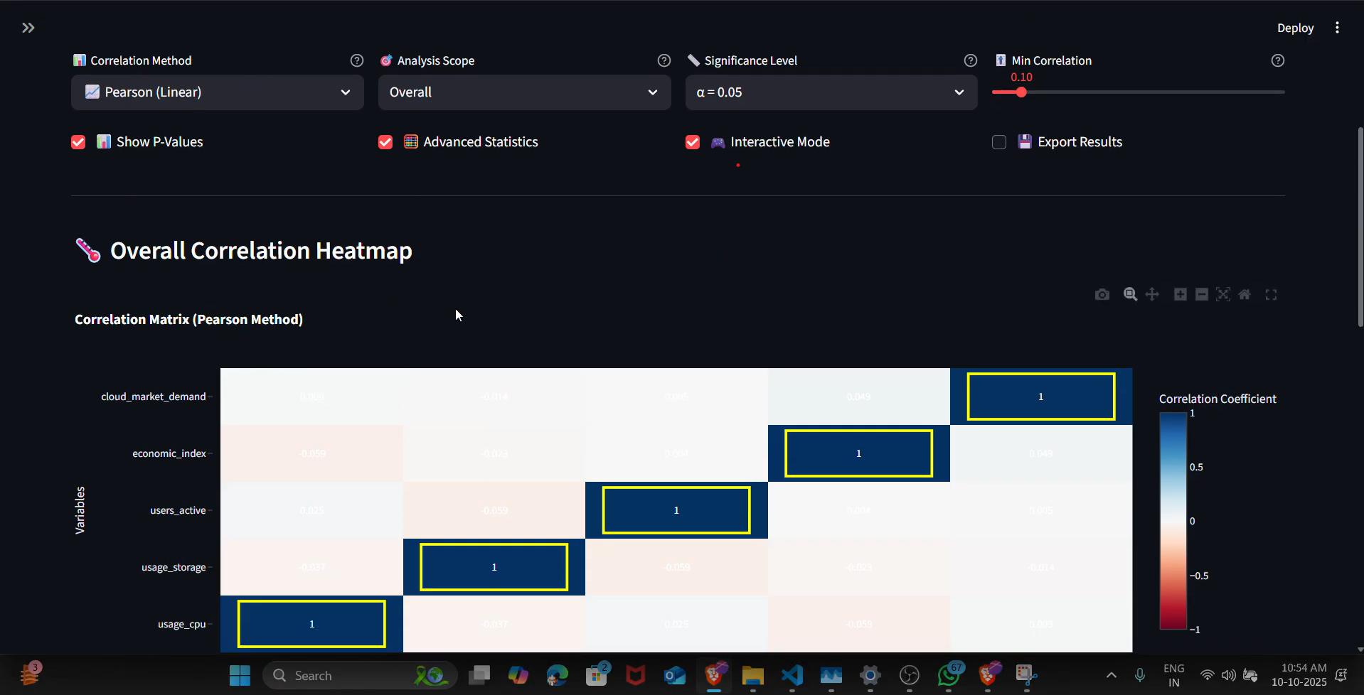
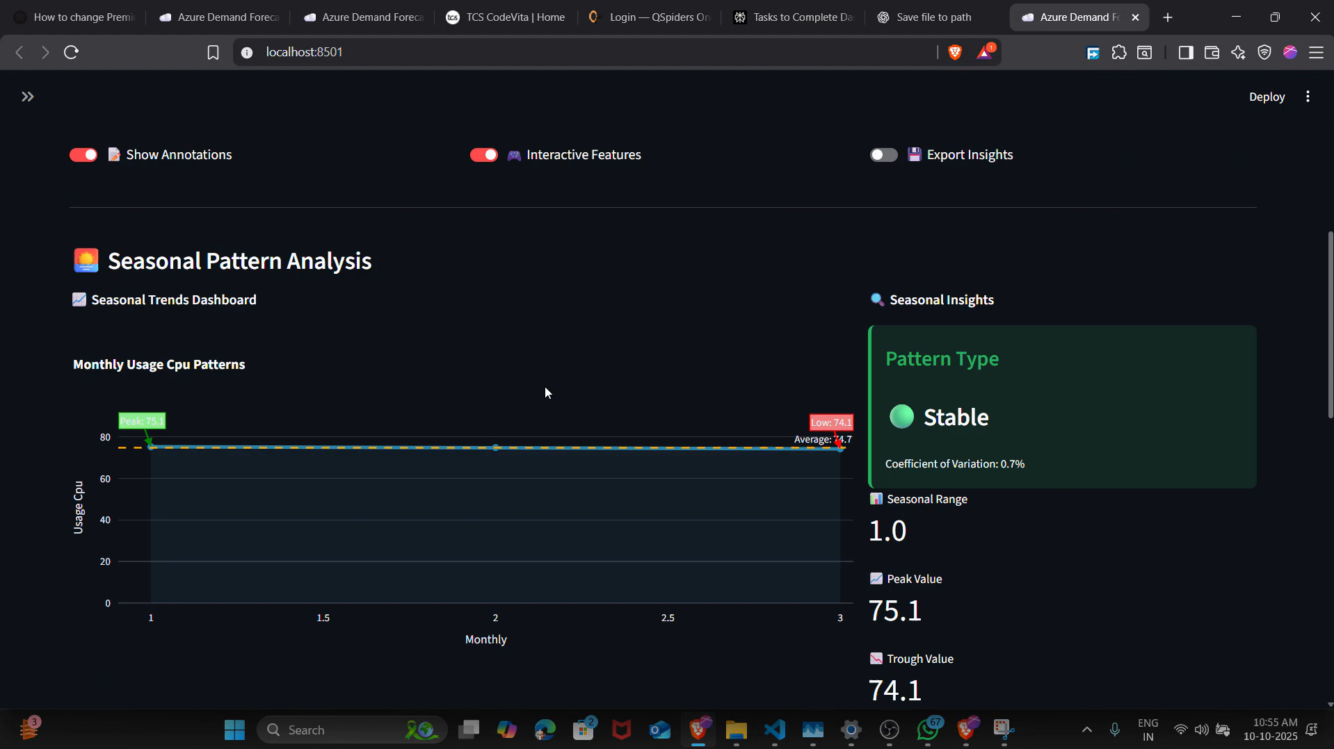
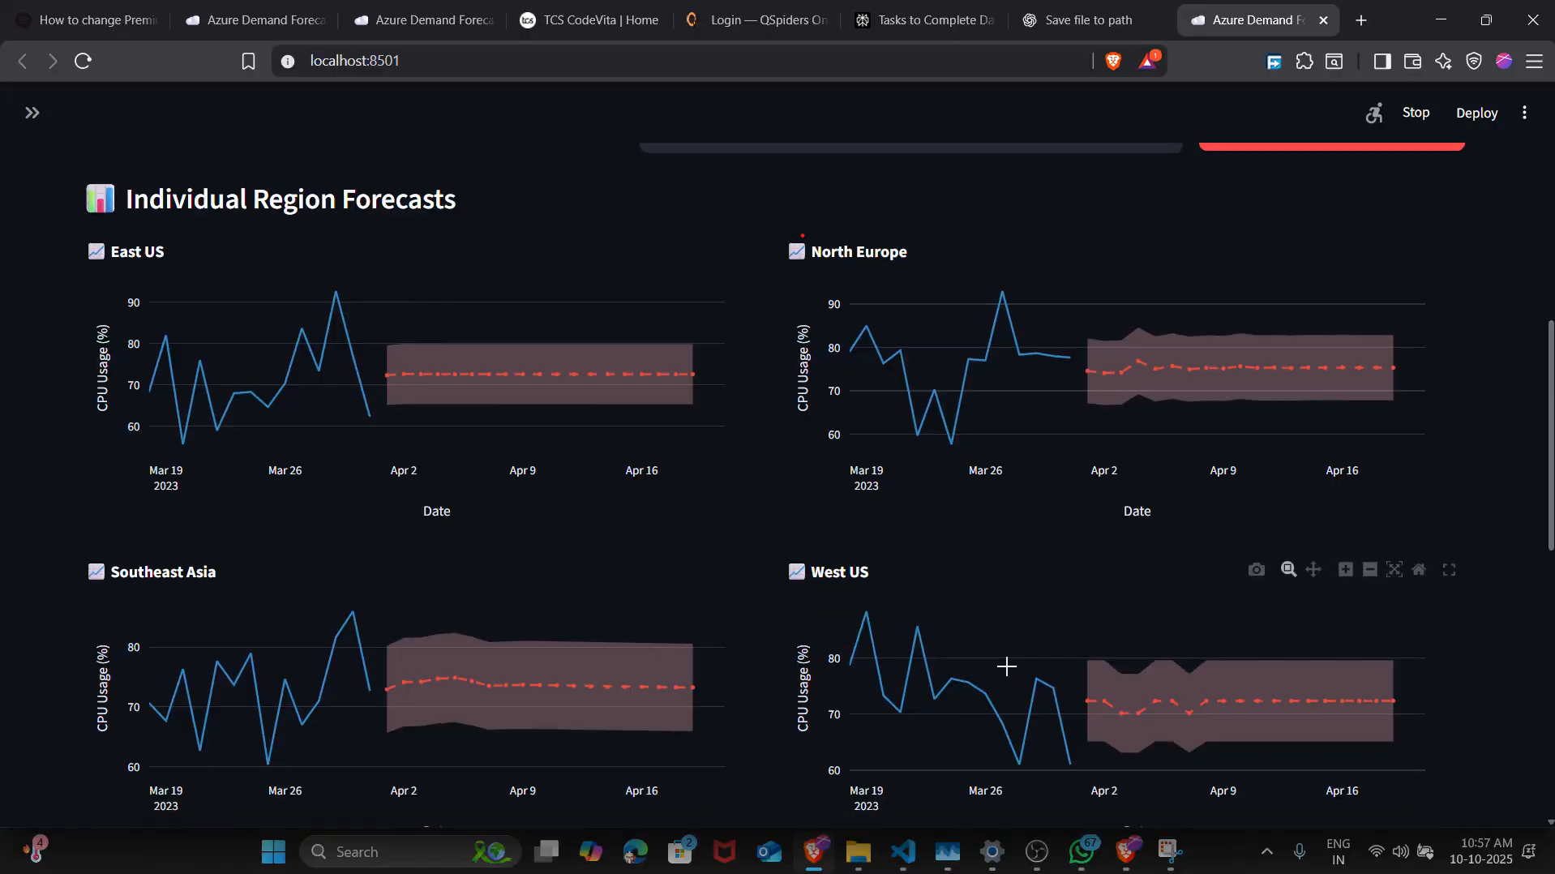

Slide 14
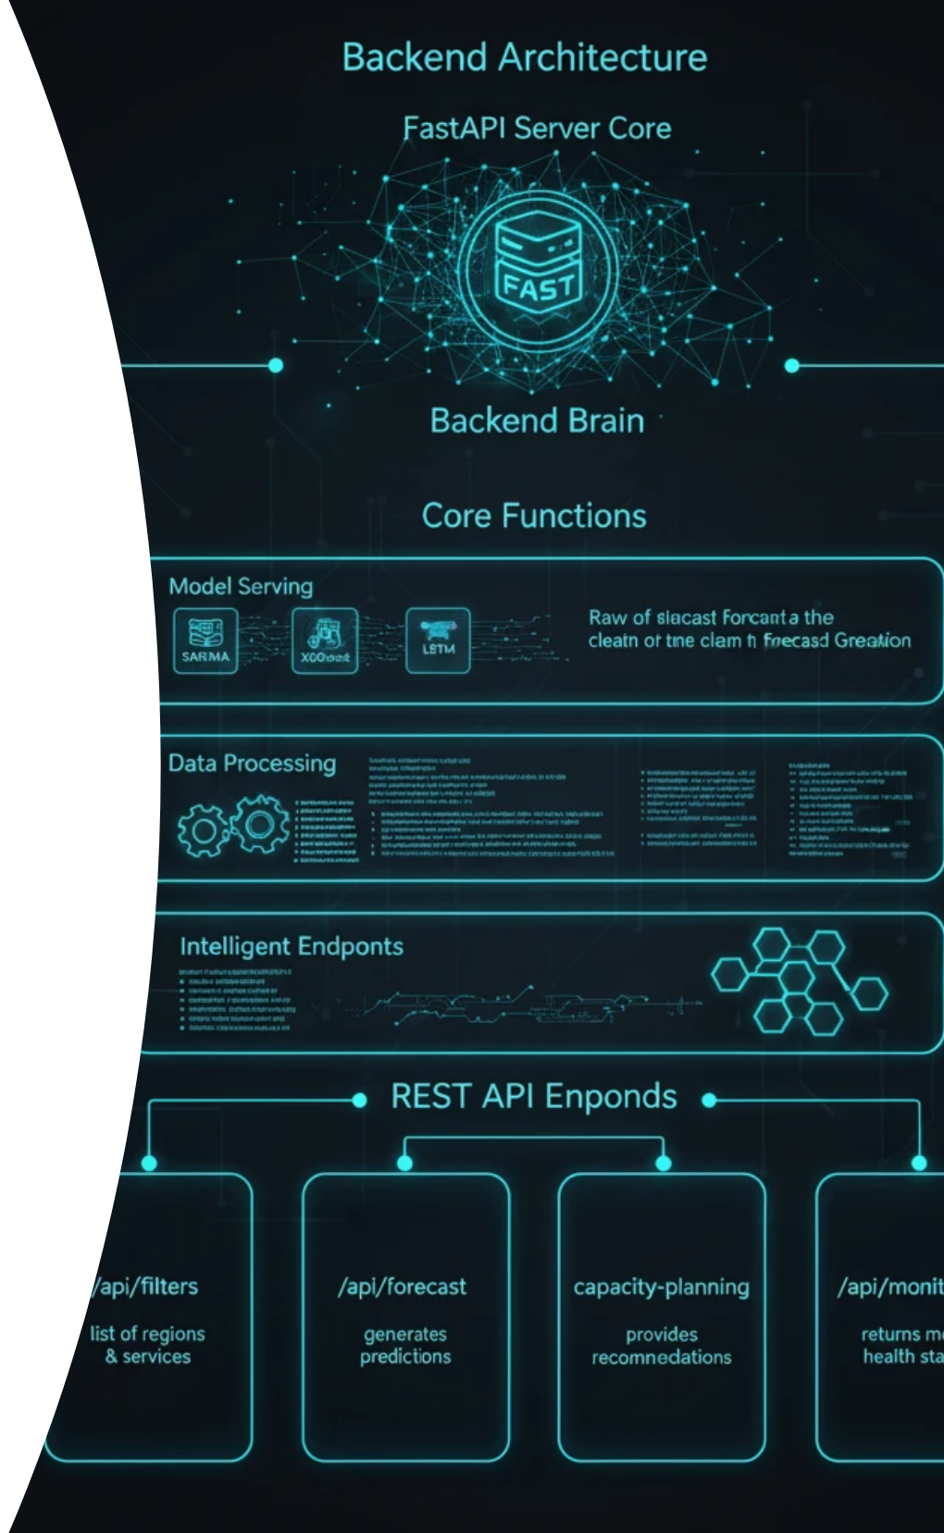








13. Backend Architecture
The backend is a robust API server built with FastAPI, serving as the application's "brain".
Functionality:
1
2
3
Model Serving
Data Processing
Intelligent Endpoints
Loads three trained models to generate real-time forecasts.
Handles complex data filtering and aggregation based on user selections.
Provides multiple REST API endpoints to serve data to the frontend.
Key Endpoints:
1
2
/api/filters
/api/forecast
Provides the list of available regions and services.
Generates a forecast using a selected model.
3
4
/api/capacity-planning
/api/monitoring
Provides a full capacity analysis and recommendation.
Returns the health status of the best model.

Slide 15
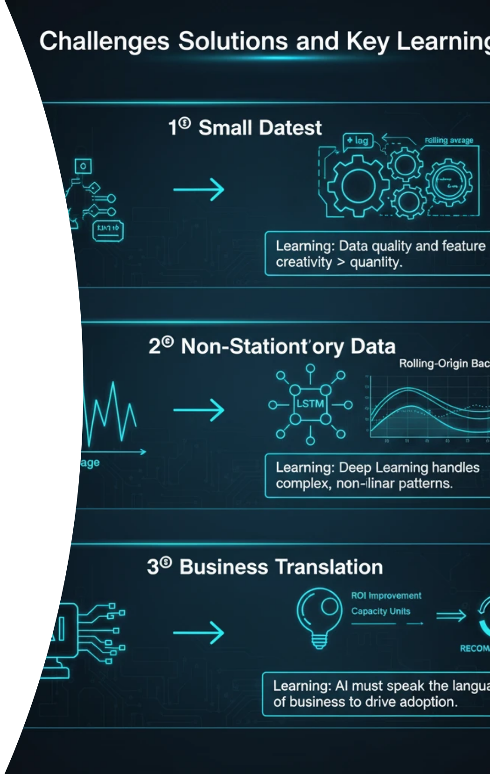
14 Challenges and Learning
Challenge | Solution Implemented | Learning
Small Dataset | Rigorous Feature Engineering (Lags, Rolling Means) | Data quality and feature creativity are more important than quantity in time series.
Non-Stationary Data | Employed LSTM and Rolling-Origin Backtesting | Deep Learning excels at handling complex, non-linear patterns.
Business Translation | Developed the Capacity Planning Engine | AI must speak the language of business to drive adoption.

Slide 16
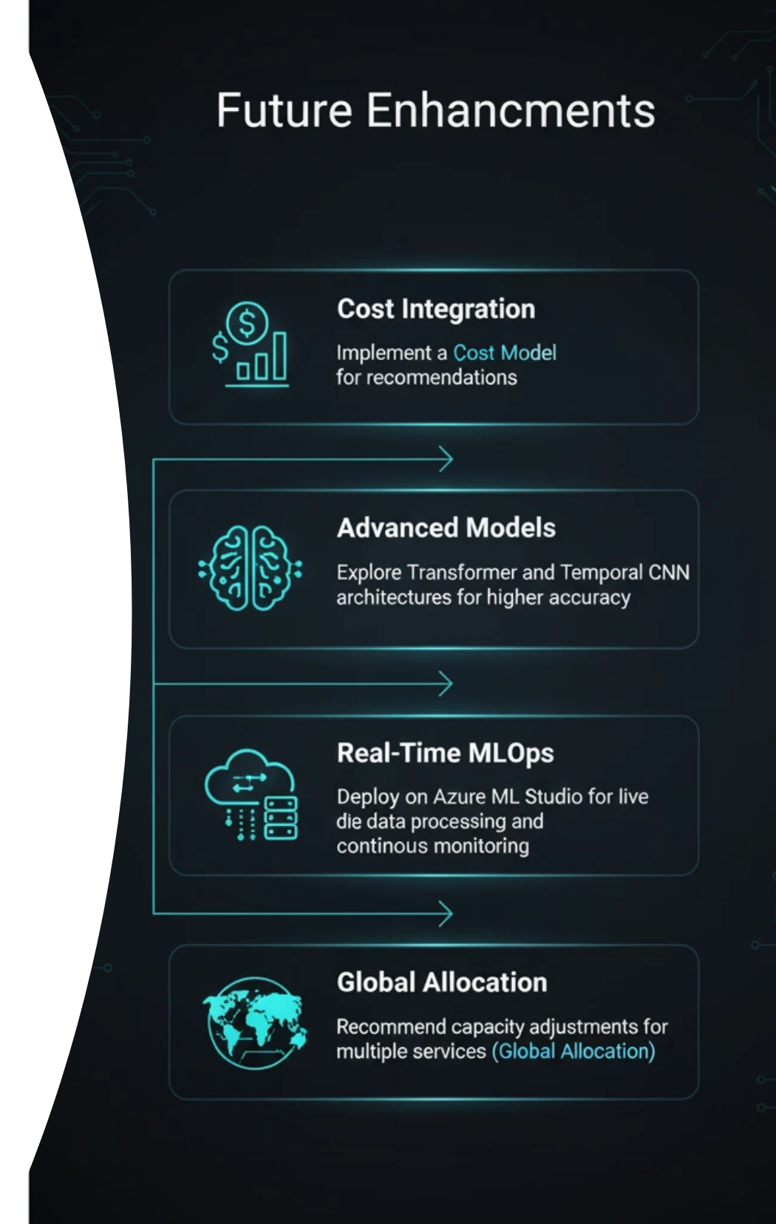






Future Enhancement
1
Cost Integration
2
Advanced Models
Implement a Cost Model for recommendations.
Explore Transformer and Temporal CNN for accuracy.
3
Real-Time MLOps
4
Global Allocation
Deploy on Azure ML Studio for live data processing.
Recommend capacity adjustments for multiple services.

Slide 17

Thank You

